Slide 1

Senior Capstone Design
Presentation 1: Intro to Project
Presented by: Brandon Knutson, Daniel Cooke, Isaiah Padilla, Mason Goodman, Mica Nellis, Russel Stringham

Slide 2
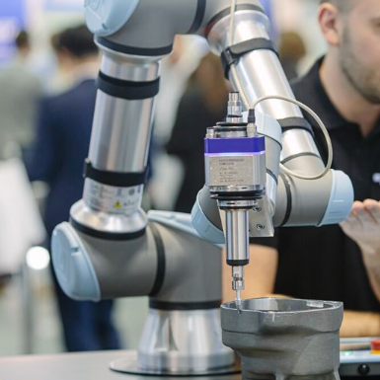
Project Description
Description:
Our team was asked to create a robotic arm drill that can locate positions on any cylinder to aid in drilling
We will create an arm with six degrees of freedom (DOF) breaking up into two sub-teams of three allocating three DOF to each sub-team
Our team will also create a drill that will have alternate drill sizes to accommodate different bolt clearances
This design will consist of a roughly four foot tall and 50-inch diameter build that must be portable
Our drill will be fully automated and require no manual controls, allowing for custom locations to be inputted within the system
The system will be required to not only locate specific positions but also apply enough force to drill through composite materials.
All drilling is expected to be strictly horizontal and perpendicular, and all drilling will be the same distance from the physical arm
Launch vehicles include cylindrical composite materials to be able to bolt secondary structures, such as brackets, to secure cables, tubing, and other devices
These cylindrical structures are used to connect the entire vehicle together using metallic joints mating on each cylindrical end
Sponsor:
Northrop Grumman Space Systems will be the sponsor for our team as well as our project, we will be working closely with Andrew Acosta, Aeronautical Engineer, as well as Arjun Banerji.
Each of them will be extremely imperative to our team and our success, not only have they experienced the capstone process but have worked in the field and can offer expert advice going forward.

Slide 3
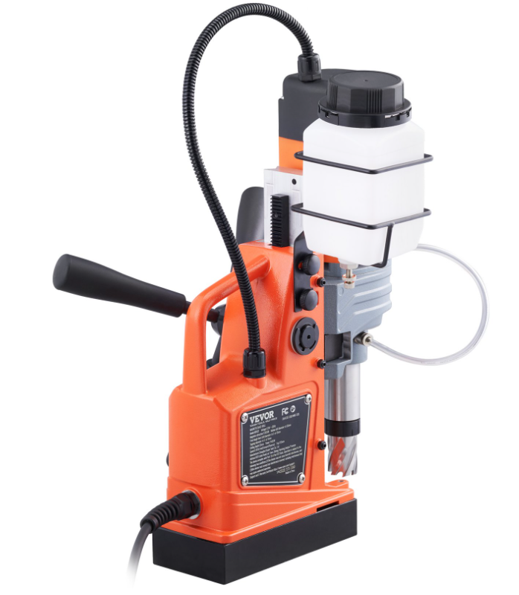
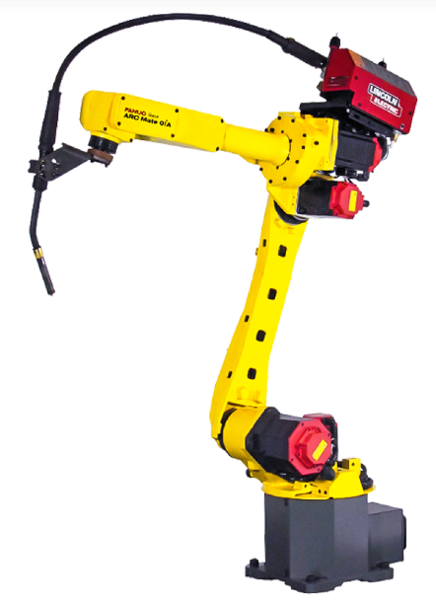
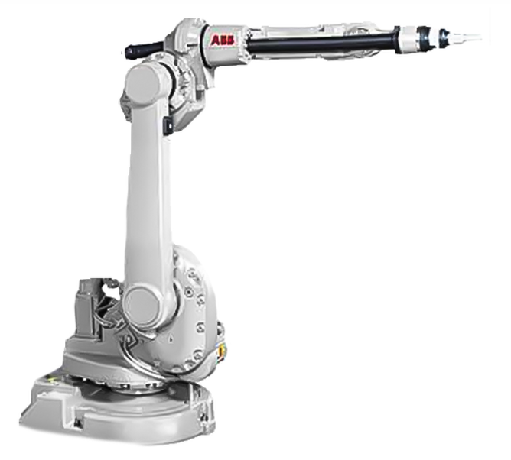
Background & Benchmarking
Fanuc Arc Mate OiA Robot
Payload – 3 kg
Axes – 6
Reach – 1437 mm
ABB IRB 1600ID Robot
Payload – 4 kg
Axes – 6
Reach – 1500 mm
VEVOR Magnetic Drill
1400 W
Twist and hole drill
Adjustable speed gears
Notes:
Fanuc Robot is a light weight, compact welding robot. Has high speed and accuracy because of new servo motor technology.
ABB's robot is also used for welding. It has internal wiring that creates a flexible and combat design.
Both have 6-axis movement therefore they can install on the floor, ceiling and at an angle
Not the same function but arm layout and pin pointing locations are designs that our drilling arm could use.
The VEVOR Magnetic drill is a portable and compact that has quick changing bits which is needed for our design. Our team will be modeling off it for the drill subassembly.

Slide 4
Customer and Engineering Requirements
Working Volume
Must be able to reach a diameter of 50 inches, as well as a height of four feet.
Drilling Capabilities
Material: Composite material equivalent to ¼'' aluminum.
Multiple drill bits for varying size holes.
Varying directions and surface conditions.
Fully Autonomous
User should be able to use control system to select a preprogrammed setting for the desired job.
E-stop that can detect overheating or system malfunction and automatically shut down.
Other
Cost effective: Low product and maintenance costs.
Must be able to work continuously through a 10 -hour workday.
Strictly electronic running on standard household appliance power access (no hydraulics).

Slide 5
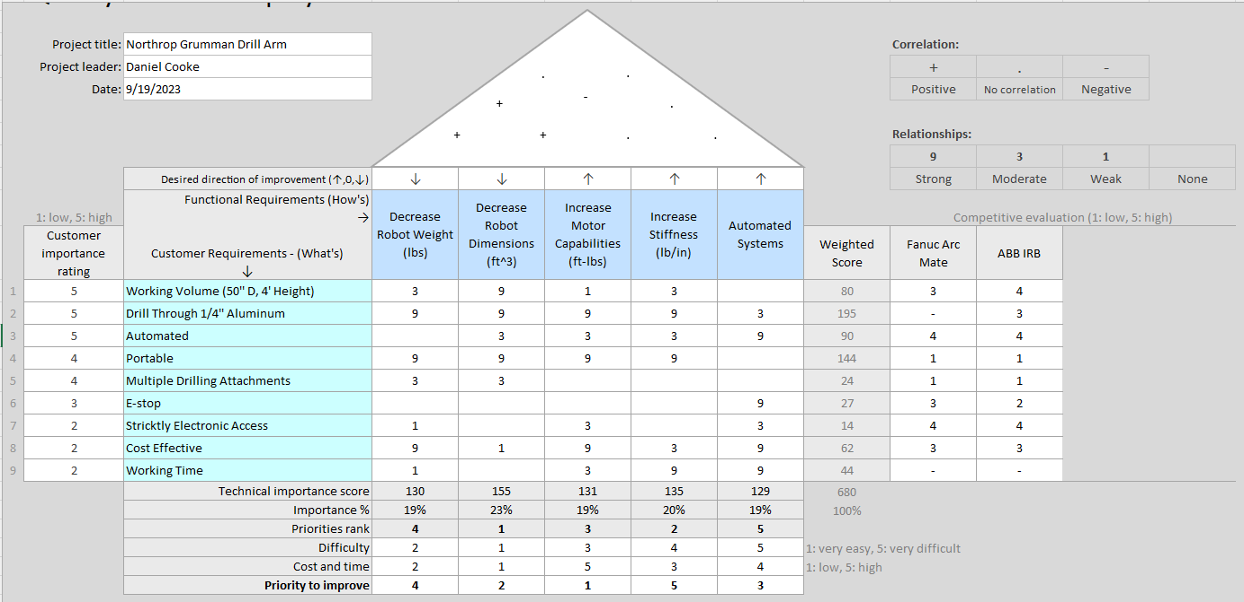
Quality Function Deployment
Priorities
Drilling Capabilities and Stiffness
Working Volume
Automated
Secondary
Portability
Multiple Drilling Attachments
Cost Effectiveness
Benchmarking
By analyzing similar product’s functions, the team can determine what subsystems need to be improved upon to make our solution more viable than the other options on the market.

Slide 6
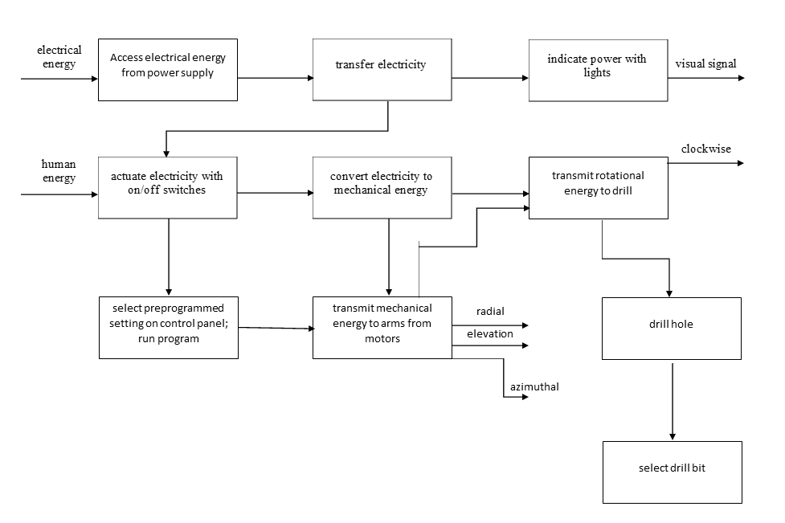
Functional Modeling
Functional Model
Structured representation of actions performed within entire system and subsystems
Shows functional outputs as instigated by energy inputs
Subsystems
Arm
Drill
Automated System
Other?

Slide 7
Research within Your Design Space – A Literature Review
Brandon Knutson:
[4] R. C. Hibbeler, ENGINEERING MECHANICS : dynamics. Pearson, 2018.
[5] R. G. Budynas, J Keith Nisbett, and Joseph Edward Shigley, Shigley’s mechanical engineering design. New York, Ny: Mcgraw-Hill Education, 2020.
[1] K. F. Tamrin, N. A. Sheikh, and S. M. Sapuan, “7 - Laser drilling of composite material: A review,” ScienceDirect, Jan. 01, 2019.https://www.sciencedirect.com/science/article/pii/B9780081023976000076#f0010 (accessed Sep. 15, 2023).
[2] A. Haidar, C. Benachaiba, and M. Zahir, “Software interfacing of servo motor with microcontroller,” Faculty of Engineering and Information Sciences - Papers: Part A, pp. 84–99, Jan. 2013, Available: https://ro.uow.edu.au/eispapers/468/
[3] G.-S. Huang, C.-K. Tung, H.-C. Lin, and S.-H. Hsiao, “Inverse kinematics analysis trajectory planning for a robot arm,” IEEE Xplore, May 01, 2011. https://ieeexplore.ieee.org/document/5899203?denied= (accessed Sep. 15, 2023).
[6] “Simulator for industrial robots and offline programming - RoboDK,” robodk.com. https://robodk.com/
[7] “Jeremy Fielding - All Things Mechanical,” Jeremy Fielding. https://jeremyfielding.com/ (accessed Sep. 15, 2023).
[8] “RCTESTFLIGHT,” RCTESTFLIGHT. https://www.rctestflight.com/ (accessed Sep. 15, 2023).
[9] tec-science, “How does a cycloidal drive work?,” tec-science, Jan. 14, 2019. https://www.tec-science.com/mechanical-power-transmission/planetary-gear/how-does-a-cycloidal-gear-drive-work/

Slide 8
Research within Your Design Space – A Literature Review
Daniel Cooke:
Books
[10] R. G. BUDYNAS, “Gears- General,” in Shigley’s Mechanical Engineering Design
Describes gear and shaft design; will be used for motor and gear box design.
[11] W. D. Callister and D. G. Rethwisch, “Mechanical Properties of Metals,”
Resource for material properties and required forces to drill through the aluminum cylinder.
Papers
[12] T. J. Baumeister, E. A. Avallone, and T. I. Baumeister, Standard Handbook for Mechanical Engineers
General resource that has information on all mechanical engineering disciplines.
[13] A. Bicchi and G. Tonietti, “Fast and ‘soft-arm’ tactics
Robot arm design.
[14] S. G. Yakovlev, “Software development for 3D visualization of G-code when working with CNC machines,”
Online Resources
[15] “What is manufacturing & Manufacturing Processes,”
Describes various manufacturing methods and their applications.
[16] “Browse Catalog,” McMaster-Carr
[17] T. Seo, G.-P. Jung, and D. Yun, Advances in Bio-Inspired Robots.

Slide 9
Research within Your Design Space – A Literature Review
Isaiah Padilla:
Books:
[17] R. G. Budynas and J. K. Nisbett, “Chapter 9 - Welding, Bonding, and the Design of Permanent Joints,” in Shigley’s Mechanical Engineering Design, 11th edition, SI units, 11th ed, S.l., NY: MCGRAW-HILL EDUCATION (AS, 2020, pp. 485–612
  Allows for our team to have a solid idea in how to bond, fasten, and connect each piece to our robotic drilling arm
[18] R. G. Budynas and J. K. Nisbett, “Chapter 4 - Deflection and Stiffness,” in Shigley’s Mechanical Engineering Design, 11th edition, SI units, 11th ed, S.l., NY: MCGRAW-HILL EDUCATION (AS, 2020, pp. 173–219
  Calculate how our robotic arm will react when experiencing high amounts of torque during drilling.
Papers: [19] G. R. Reddy and V. K. Eranki, “Design and Structural Analysis of a Robotic Arm,” thesis, Karlskrona, 2016
  Helps in creating "joints that move in vertical and horizontal directions"
[20] R. Gautam, A. Gedam, A. Zade, and A. Mahawadiwar, Review on Development of Industrial Robotic Arm. International Research Journal of Engineering and Technology, 2017
  Shows how to create a robotic arm that is "lightweight and uses lightweight materials"
[21] M. Z. Silva, T. Brito, J. L. Lima and M. F. Silva, "Industrial Robotic Arm in Machining Process Aimed to 3D Objects Reconstruction," 2021 22nd IEEE International Conference on Industrial Technology (ICIT), Valencia, Spain, 2021, pp. 1100-1105, doi: 10.1109/ICIT46573.2021.9453596.
  Will be useful when considering the portability of our design
  Another viable resource in G-Code 3D visualization software important in the drilling aspect of our project
Online Resources: How to Robot and Xometry
[22] M. Fairchild, “Drilling robots: Automate for fast and precise results,” #HowToRobot, https://howtorobot.com/expert-insight/drilling-robots (accessed Sep. 15, 2023).
  Provides what industries are already using drilling robots
  Main uses for various robots in the industry
  Provides potential outreach opportunities for not only more advice but as well as donated materials
[23] T. Xometry, “Drilling machines - parts, types, and uses,” Xometrys RSS, https://www.xometry.com/resources/machining/drilling-machines/ (accessed Sep. 15, 2023).
  Shows different "parts of a drilling machine, the different types of machines available, and the specific uses of these machines"
  Will be helpful in the same ways stated above but also help break down the parts of a drilling machine

Slide 10
Research within Your Design Space – A Literature Review
Mason Goodman:
Books: Springer Handbook of Robotics: With 84 Tables and ‘Chapter 11 - Implementation ’, in Engineering by design.
Kinematic section provides useful information regarding robot movement
Motion Planning & Motion Control section can provide options for team design
Materials Selection in Design
Common Fabrication Materials
Provide steps in engineering design and their importance relating heavily throughout our entire project when designing
Papers: "Development of Robotic Arm Prototype,", , "A Review of Current Techniques for Robotic Arm Manipulation and Mobile Navigation,", and "Design of geometric-based inverse kinematics for a low-cost robotic arm,"
Describes 4 different types of manipulation within robotics
Help to provide improved efficiency and functionality within our design
Example of inverse kinematics when having a low budget
Help to ensure we stay within our budget throughout the project while providing our team with ideas during build
Online Resources: The Demeter Project and “Simplify Robot Programming with G-code - Universal Robots,”
A small course to help walkthrough creating a robotic arm
Another in depth resource in G-Code to help with ensuring a fully automated device

Slide 11
Research within Your Design Space – A Literature Review
Mica Nellis:
Books:
[31] R. G. Budynas and J. K. Nisbett, “Chapter 5- Failure Resulting from Static Loading,” in Shigley’s Mechanical Engineering Design, 11th edition
Possibility of failure and how to fix and reevaluate what had gone wrong during this process[31]
[32] R. G. Budynas and J. K. Nisbett, “Chapter 18 – Power Transmission Case Study,” in Shigley’s Mechanical Engineering Design
Breakdown of different case studies for power transmission[32]
Helpful when considering the torque outputted in our drilling component
Papers:
[33] A. Imran and B.-J. Yi, “Performance Analysis of 7-DOF Robotic Arm for Drilling and Milling Applications,”
Robotic drilling arm that may be helpful when designing and building our own
[34] Garnier, Sebastien & Subrin, Kévin & Waiyagan, Kriangkrai. (2017). Modelling of Robotic Drilling
Breaks down various components of the arm that was built and "analyzed in terms of linear and angular external impulses for drilling and milling applications."[34].
[35] Implicit force and position control to improve drilling quality in CFRP flexible robotic machining. Journal of Manufacturing Processes.
Implicit force and position control to improve drilling quality in carbon fiber reinforced plastic (CRFP) Flexible Robotic Machining [35]
Discusses the many issues within the material used within robotic machining, deviations in drilling
Online Sources:
[36] “Robotic arm design: Types & components of robotic arms.”
[37] “4. Robot end-of arm tooling – Inlearc.”
How to choose an end effector which will be imperative in our design.
Provides our team with examples and assemblies of end of arm tooling.

Slide 12
Research within Your Design Space – A Literature Review
Russel Stringham:
Books:
[1] R. G. Budynas and J. K. Nisbett, “Chapter 12- Lubrication and Journal Bearings,” in Shigley’s Mechanical Engineering Design, 11th edition, SI units, 11th ed, S.l., NY: MCGRAW-HILL EDUCATION (AS, 2020, pp. 623-677)
[2] R. G. Budynas and J. K. Nisbett, “Chapter 20- Geometric Dimensioning and Tolerancing,” in Shigley’s Mechanical Engineering Design, 11th edition, SI units, 11th ed, S.l., NY: MCGRAW-HILL EDUCATION (AS, 2020, pp. 977-1012)
Shows how lubrication is used to reduce friction and wear and able to calculate tolerances for the dimensions in the design
Papers:
[1] Dimensioning and Tolerancing, ASME Y14.5-2009, American Society of Mechanical Engineers, 2009
[2] Drawing Practice, ASME Y14.100-2004, American Society of Mechanical Engineers, 2004
[3] Types and Applications of Engineering Drawings, ASME Y14.24-2012, American Society of Mechanical Engineers, 2012
Establishes standards on dimensioning and tolerances and ensures all standards are consistent throughout engineering drawings
Online Resources:
[1] “Fanuc ARC Mate 0iA Robot | Robots.com,” T.I.E. Industrial. https://www.robots.com/robots/fanuc-arc-mate-0ia (accessed Sep. 18, 2023).
[2] “ABB IRB 1600ID Robot | Robots.com,” T.I.E. Industrial. https://www.robots.com/robots/abb-irb-1600id (accessed Sep. 18, 2023).
[3] “High Quality Equipment And Tool With Unbeatable Price | VEVOR Official,” Vevor US. https://www.vevor.com
Robots.com shows different state-of-the-art designs to reference

Slide 13
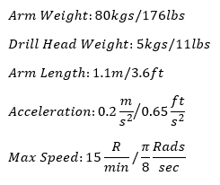
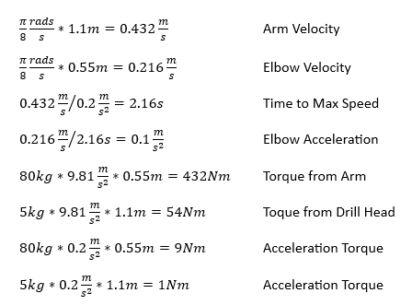
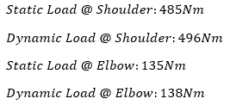
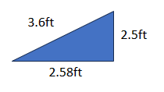
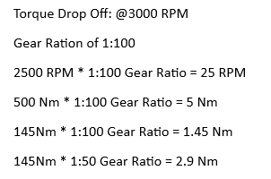
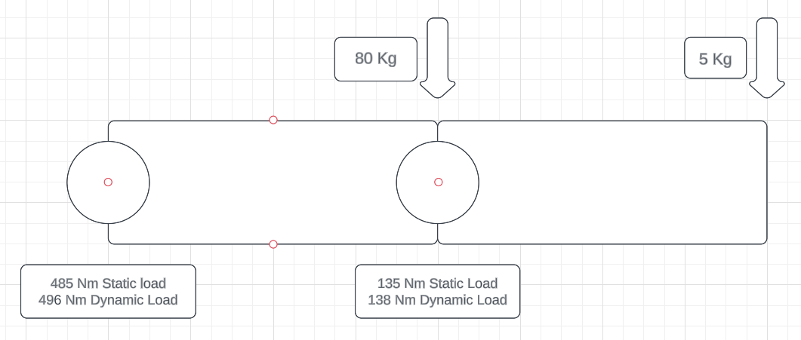

Initial Calculations – Mathematical Modeling
Physical Properties
Motor Requirements
[4-5]

Slide 14
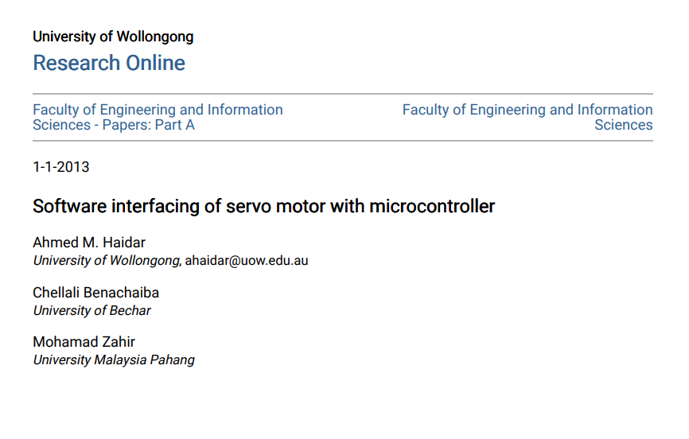
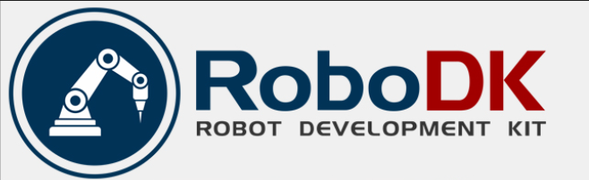
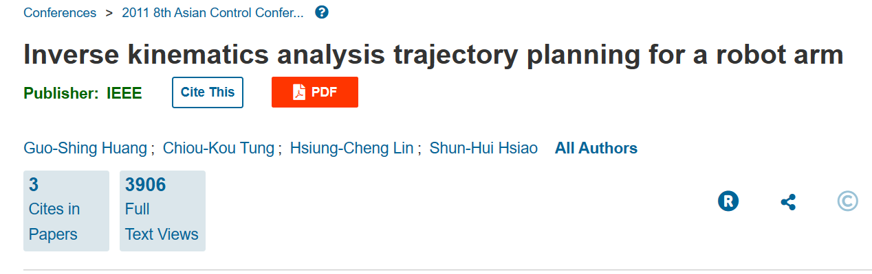
Engineering Tools – Mathematical Modeling
University of Wallongong Microcontroller and Matlab GUI to control servomotor
National Chin-Yi University of Technology: Report on the reverse kinematics for a 6-axis robot arm
RoboDK Robot: Simulation Program that translates to the programming of the robot
Use of Ruby-Titanium Laser used for composite cutting
[1-3,6]

Slide 15
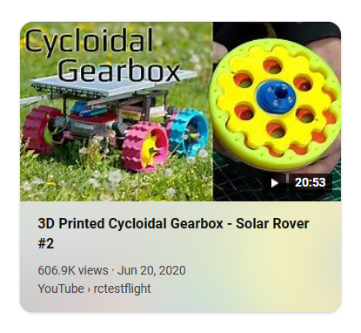
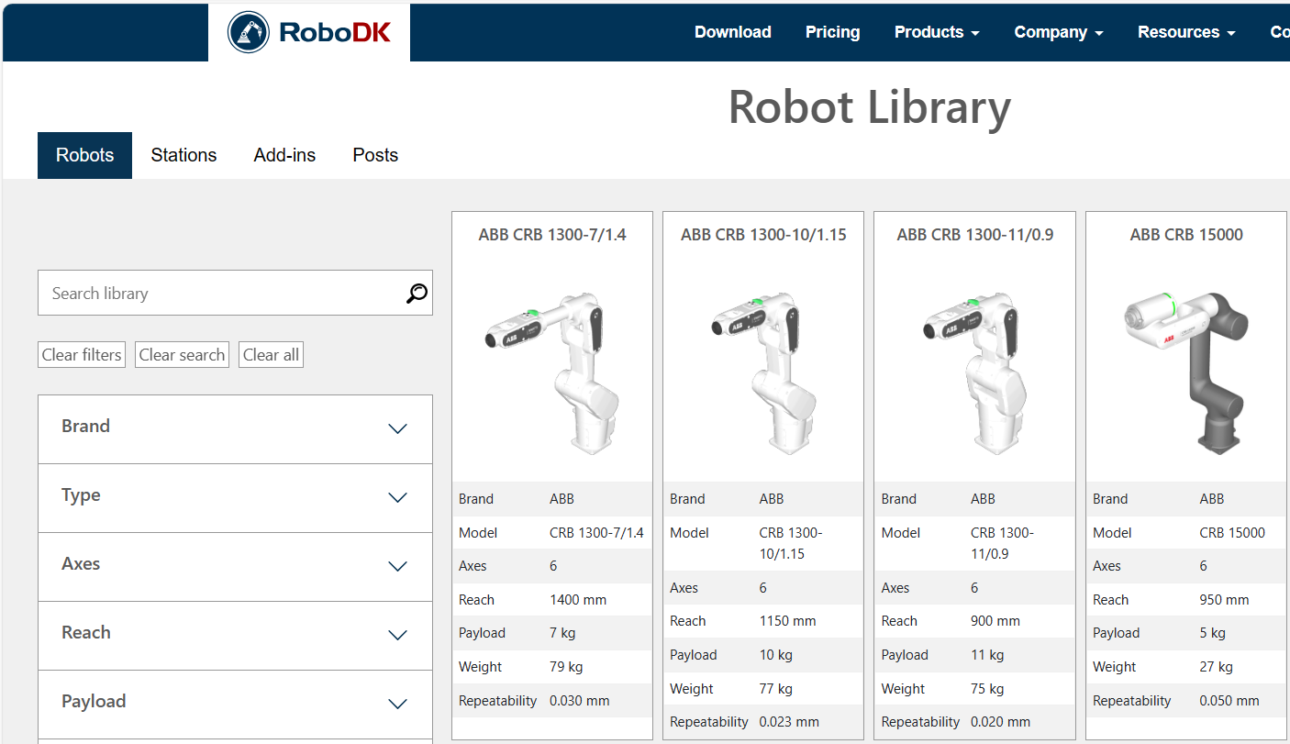
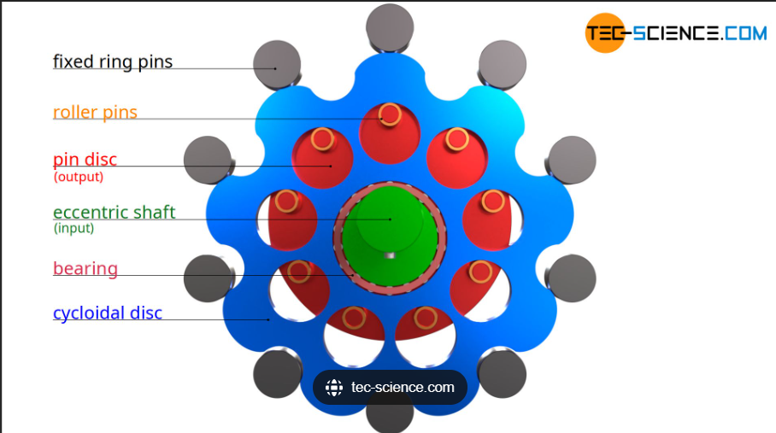
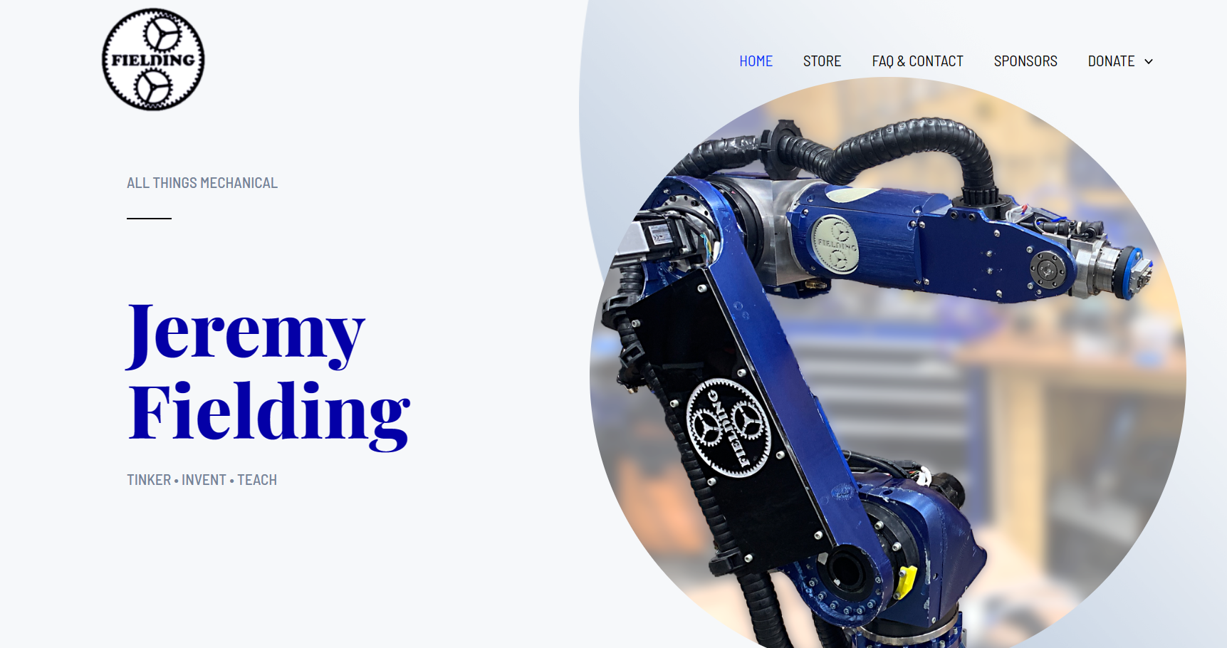
Examples – Mathematical Modeling
Jeremy Fielding: Documentation of own robot design
Robo DK library
  AUBO I5
Cycloidal Drives: Compact, machinable and high ratio power transfer method
[6-9]

Slide 16



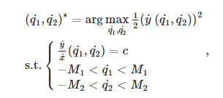
Research within Your Design Space – Mathematical Modeling
Finding max velocity in the end effector[46]
Creating a path to solve inverse kinematics
Assigning desired v with a given magnitude and direction
Solve for each point in the path using
Use inverse Jacobian
Solving for q1 and q2 having (a) values be link lengths (more for our robot given we'll have more links)
Then use velocity equations
Determining max velocity

Slide 17
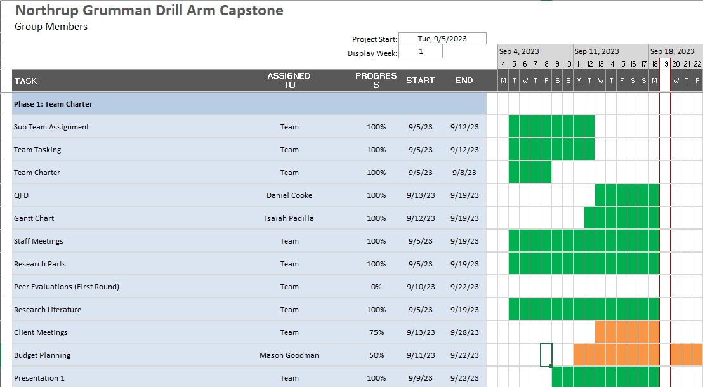
Schedule
• Green cells show completed tasks, white cells show unstarted tasks, and orange cells represent tasks currently being worked on but not yet finished.
Gantt chart represents work projections for the semester in general task form.

Slide 18
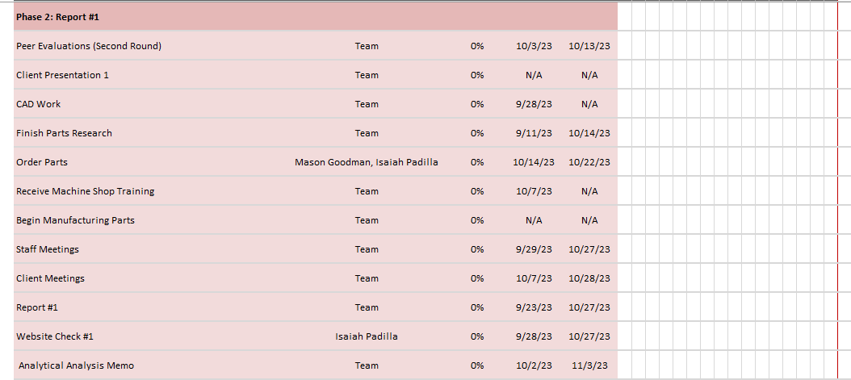

Schedule

Slide 19

Schedule

Slide 20
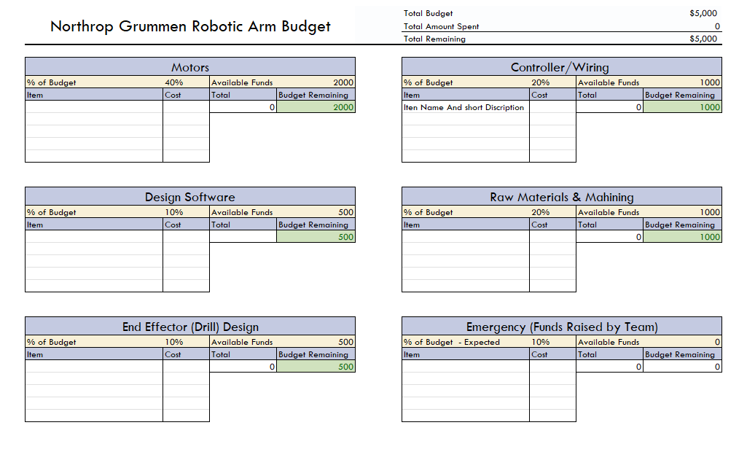
Budget
• Team & Client Working Budget
  Current Amount
  Available Amount
  Expectations
Anticipated Expenses
  Five Major Expense Areas
  Plan to Raise Funds
Purchase Orders & Receipts
  Client Expectation of the Purchasing Process

Slide 21
QUESTIONS?

Slide 22
References
[1] K. F. Tamrin, N. A. Sheikh, and S. M. Sapuan, “7 - Laser drilling of composite material: A review,” ScienceDirect, Jan. 01, 2019.https://www.sciencedirect.com/science/article/pii/B9780081023976000076#f0010 (accessed Sep. 15, 2023).
[2] A. Haidar, C. Benachaiba, and M. Zahir, “Software interfacing of servo motor with microcontroller,” Faculty of Engineering and Information Sciences - Papers: Part A, pp. 84–99, Jan. 2013, Available: https://ro.uow.edu.au/eispapers/468/
‌[3] G.-S. Huang, C.-K. Tung, H.-C. Lin, and S.-H. Hsiao, “Inverse kinematics analysis trajectory planning for a robot arm,” IEEE Xplore, May 01, 2011. https://ieeexplore.ieee.org/document/5899203?denied= (accessed Sep. 15, 2023).
[4] R. C. Hibbeler, ENGINEERING MECHANICS : dynamics. Pearson, 2018.
‌[5] R. G. Budynas, J Keith Nisbett, and Joseph Edward Shigley, Shigley’s mechanical engineering design. New York, Ny: Mcgraw-Hill Education, 2020.
‌[6] “Simulator for industrial robots and offline programming - RoboDK,” robodk.com. https://robodk.com/
[7] “Jeremy Fielding - All Things Mechanical,” Jeremy Fielding. https://jeremyfielding.com/ (accessed Sep. 15, 2023).
[8] “RCTESTFLIGHT,” RCTESTFLIGHT. https://www.rctestflight.com/ (accessed Sep. 15, 2023).
[9] tec-science, “How does a cycloidal drive work?,” tec-science, Jan. 14, 2019. https://www.tec-science.com/mechanical-power-transmission/planetary-gear/how-does-a-cycloidal-gear-drive-work/
‌[10] R. G. BUDYNAS, “Gears- General,” in Shigley’s Mechanical Engineering Design, 11th ed, MCGRAW-HILL EDUCATION, 2019
[11] W. D. Callister and D. G. Rethwisch, “Mechanical Properties of Metals,” in Materials science and engineering: An introduction, 10th ed, Milton, QLD: John Wiley and Sons Australia, Ltd, 2021
[12] T. J. Baumeister, E. A. Avallone, and T. I. Baumeister, Standard Handbook for Mechanical Engineers, 7th ed. New York: McGraw-Hill Book, 1978.
[13] A. Bicchi and G. Tonietti, “Fast and ‘soft-arm’ tactics,” IEEE Robotics &amp; Automation Magazine, vol. 11, no. 2, pp. 22–33, 2004. doi:10.1109/mra.2004.1310939
[14] S. G. Yakovlev, J. K. Keldibekov, and I. M. Gorbachenko, “Software development for 3D visualization of G-code when working with CNC machines,” Journal of Physics: Conference Series, vol. 1515, no. 2, p. 022082, 2020. doi:10.1088/1742-6596/1515/2/022082

Slide 23
References
[15] “What is manufacturing & Manufacturing Processes,” Engineering Product Design, https://engineeringproductdesign.com/knowledge-base/manufacturing-processes/ (accessed Sep. 17, 2023).
[16] “Browse Catalog,” McMaster-Carr, https://www.mcmaster.com/ (accessed Sep. 17, 2023).
[17] R. G. Budynas and J. K. Nisbett, “Chapter 9 - Welding, Bonding, and the Design of Permanent Joints,” in Shigley’s Mechanical Engineering Design, 11th edition, SI units, 11th ed, S.l., NY: MCGRAW-HILL EDUCATION (AS, 2020, pp. 485–612
[18] R. G. Budynas and J. K. Nisbett, “Chapter 4 - Deflection and Stiffness,” in Shigley’s Mechanical Engineering Design, 11th edition, SI units, 11th ed, S.l., NY: MCGRAW-HILL EDUCATION (AS, 2020, pp. 173–219
[19] G. R. Reddy and V. K. Eranki, “Design and Structural Analysis of a Robotic Arm,” thesis, Karlskrona, 2016
[20] R. Gautam, A. Gedam, A. Zade, and A. Mahawadiwar, Review on Development of Industrial Robotic Arm. International Research Journal of Engineering and Technology, 2017
[21] M. Z. Silva, T. Brito, J. L. Lima and M. F. Silva, "Industrial Robotic Arm in Machining Process Aimed to 3D Objects Reconstruction," 2021 22nd IEEE International Conference on Industrial Technology (ICIT), Valencia, Spain, 2021, pp. 1100-1105, doi: 10.1109/ICIT46573.2021.9453596.
[22] M. Fairchild, “Drilling robots: Automate for fast and precise results,” #HowToRobot, https://howtorobot.com/expert-insight/drilling-robots (accessed Sep. 15, 2023).
[23] T. Xometry, “Drilling machines - parts, types, and uses,” Xometrys RSS, https://www.xometry.com/resources/machining/drilling-machines/ (accessed Sep. 15, 2023).
[24] B. Siciliano and O. Khatib, Springer Handbook of Robotics: With 84 Tables. Berlin: Springer, 2008.
[25] Voland, G. (2014) ‘Chapter 11 - Implementation ’, in Engineering by design. Harlow: Pearson Education Limited.
[26] A. Chaudhari, K. Rao, K. Rudrawar, P. Randhavan and P. Raut, "Development of Robotic Arm Prototype," 2023 International Conference on Sustainable Computing and Data Communication Systems (ICSCDS), Erode, India, 2023, pp. 1053-1057, doi: 10.1109/ICSCDS56580.2023.10104928

Slide 24
References
[27] T. Sieusankar and B. Chandrasekaran, "A Review of Current Techniques for Robotic Arm Manipulation and Mobile Navigation," 2023 IEEE 13th Annual Computing and Communication Workshop and Conference (CCWC), Las Vegas, NV, USA, 2023, pp. 1070-1075, doi: 10.1109/CCWC57344.2023.10099115.
[28] M. A. Muslim and S. N. Urfin, "Design of geometric-based inverse kinematics for a low cost robotic arm," 2014 Electrical Power, Electronics, Communicatons, Control and Informatics Seminar (EECCIS), Malang, Indonesia, 2014, pp. 82-86, doi: 10.1109/EECCIS.2014.7003724.
[29] “How to create a robotic arm with your students - The Demeter Project,” The Demeter Project, 2021. https://www.thematic-learning.com/course/how-to-create-a-robotic-arm-with-your-students/?tab=tab-curriculum (accessed Sep. 18, 2023).
[30] “Simplify Robot Programming with G-code - Universal Robots,” www.universal-robots.com. https://www.universal-robots.com/blog/simplify-robot-programming-with-g-code/
[31] R. G. Budynas and J. K. Nisbett, “Chapter 5- Failure Resulting from Static Loading,” in Shigley’s Mechanical Engineering Design, 11th edition, SI units, 11th ed, S.l., NY: MCGRAW-HILL EDUCATION (AS, 2020, pp. 241-275)
[32] R. G. Budynas and J. K. Nisbett, “Chapter 18 – Power Transmission Case Study,” in Shigley’s Mechanical Engineering Design, 11th edition, SI units, 11th ed, S.l., NY: MCGRAW-HILL EDUCATION (AS, 2020, pp. 937-953)
[33] A. Imran and B.-J. Yi, “Performance Analysis of 7-DOF Robotic Arm for Drilling and Milling Applications,” Performance Analysis of 7-DOF Robotic Arm for Drilling and Milling Applications, Jun. 2018, doi: 10.1109/urai.2018.8441826.
[34] Garnier, Sebastien & Subrin, Kévin & Waiyagan, Kriangkrai. (2017). Modelling of Robotic Drilling. Procedia CIRP. 58. 416-421. 10.1016/j.procir.2017.03.246.
[35] Jinho, Lee & Hong, Taehwa & Seo, Chang-Hoon & Jeon, Yong & Lee, Moon & Kim, Hyo-Young. (2021). Implicit force and position control to improve drilling quality in CFRP flexible robotic machining. Journal of Manufacturing Processes. 68. 1123-1133. 10.1016/j.jmapro.2021.06.038.
[36] “Robotic arm design: Types & components of robotic arms.” https://www.universal- robots.com/in/blog/robotic-arm-design/ (accessed Sep. 15, 2023).
[37] “4. Robot end-of arm tooling – Inlearc.” https://www.tthk.ee/inlearcs/7-robot-end-of-arm- tooling/ (accessed Sep. 15, 2023).

Slide 25
References
[38] R. G. Budynas and J. K. Nisbett, “Chapter 12- Lubrication and Journal Bearings,” in Shigley’s Mechanical Engineering Design, 11th edition, SI units, 11th ed, S.l., NY: MCGRAW-HILL EDUCATION (AS, 2020, pp. 623-677)
[39] R. G. Budynas and J. K. Nisbett, “Chapter 20- Geometric Dimensioning and Tolerancing,” in Shigley’s Mechanical Engineering Design, 11th edition, SI units, 11th ed, S.l., NY: MCGRAW-HILL -EDUCATION (AS, 2020, pp. 977-1012)
[40] Dimensioning and Tolerancing, ASME Y14.5-2009, American Society of Mechanical Engineers, 2009
[41] Drawing Practice, ASME Y14.100-2004, American Society of Mechanical Engineers, 2004
[42] Types and Applications of Engineering Drawings, ASME Y14.24-2012, American Society of Mechanical Engineers, 2012
[43] “Fanuc ARC Mate 0iA Robot | Robots.com,” T.I.E. Industrial. https://www.robots.com/robots/fanuc-arc-mate-0ia (accessed Sep. 18, 2023).
[44] “ABB IRB 1600ID Robot | Robots.com,” T.I.E. Industrial. https://www.robots.com/robots/abb-irb-1600id (accessed Sep. 18, 2023).
[45] “High Quality Equipment And Tool With Unbeatable Price | VEVOR Official,” Vevor US. https://www.vevor.com
[46] “Hot Questions - Stack Exchange,” Stackexchange.com, 2019. https://stackexchange.com/
‌

